Slide 1
CardioPredict
Heart Disease Prediction
Dataset: 270,000 patients · Kaggle Model: Gradient Boosting
March 2026

Slide 2
1. Task Description & Relevance — WHO Data
Why does this matter?
Heart disease — #1 cause of death worldwide
Binary classification: Normal (0) vs Disease (1)
12 measurable clinical features from real patients
Source: GBD Study, JACC September 2025
19.2M
33%
10,000
35.6M
Deaths in 2023 (WHO)
of all deaths worldwide
deaths/day in Europe
projected by 2050
Source: GBD Study JACC September 2025 / WHO Europe
Eastern Europe & Central Asia — highest mortality region by 2050
Heart Disease Prediction · March 2026

Slide 3
1. Business Case — Private Clinic
The Problem
CardioPredict Solution
200 patients/day A cardiologist cannot examine everyone in detail. Without prioritization: • High-risk patients wait
• Doctor time wasted on low-risk
• Delayed diagnosis = worse outcomes
2 min
Patient fills 12-field form
Instant
System predicts risk level
Priority
Doctor sees who needs help first
Low Risk →
quick consult, free doctor time
Moderate Risk →
additional tests
High Risk →
immediate cardiologist
CardioPredict does not replace the doctor — it helps prioritize (medical triage)
Heart Disease Prediction · March 2026

Slide 4
2. Dataset — 13 Clinical Features
Feature | Type | Range / Values | Clinical Meaning
Age | Numeric | 29–77 years | Patient age
Sex | Binary | 0=Female, 1=Male | Patient gender
Chest pain type | Nominal | 1,2,3,4 | 1=Typical,2=Atypical,3=Non-typical,4=Asymptomatic
BP | Numeric | 94–200 mmHg | Resting blood pressure
Cholesterol | Numeric | 126–564 mg/dl | Serum cholesterol
FBS over 120 | Binary | 0=No, 1=Yes | Fasting blood sugar > 120 mg/dl
Max HR | Numeric | 71–202 bpm | Max heart rate during exercise
Exercise angina | Binary | 0=No, 1=Yes | Chest pain during exercise
ST depression | Numeric | 0.0–6.2 | ST segment depression
Vessels fluro | Ordinal | 0,1,2,3 | Major vessels in fluoroscopy
Thallium ★ | Nominal | 3,6,7 | Source of target — removed after creating label
target | Binary | 0=Normal, 1=Disease | Derived: Thallium != 3 → Disease
Heart Disease Prediction · March 2026

Slide 5
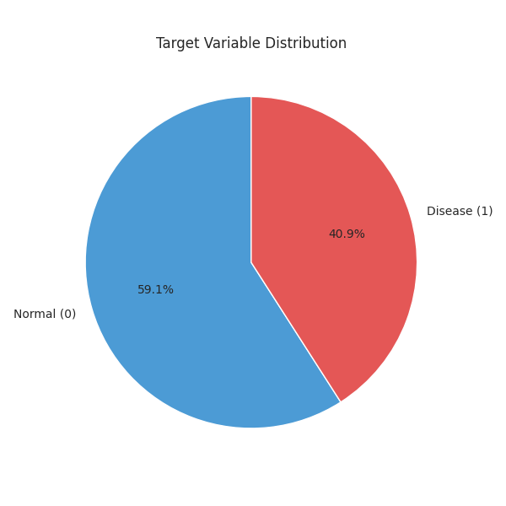
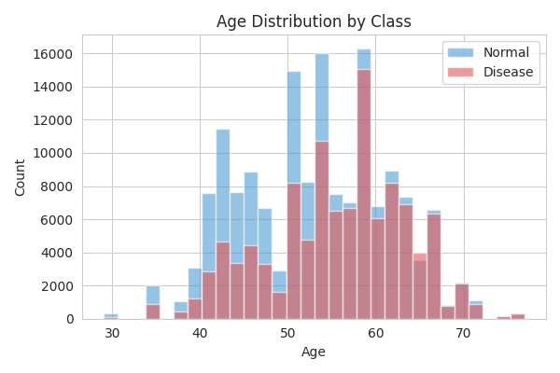
3. EDA — Target Distribution & Age Analysis
Target Variable Distribution
Age Distribution by Class
59.1% Normal (159,498 records) 40.9% Disease (110,502 records) Ratio 1.44:1 — moderate imbalance, SMOTE not needed.
Disease patients concentrate in 50–65 age range. Mean 54.2 years. Slight left skew (-0.171). Risk grows from 18% at age 29–40 to 52% at 71–77.
Heart Disease Prediction · March 2026

Slide 6
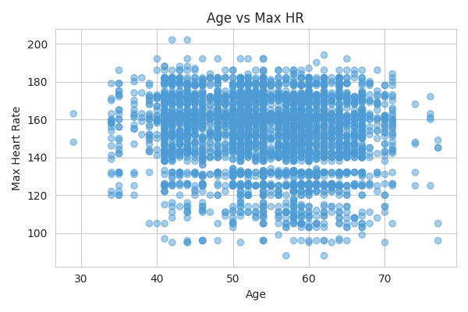
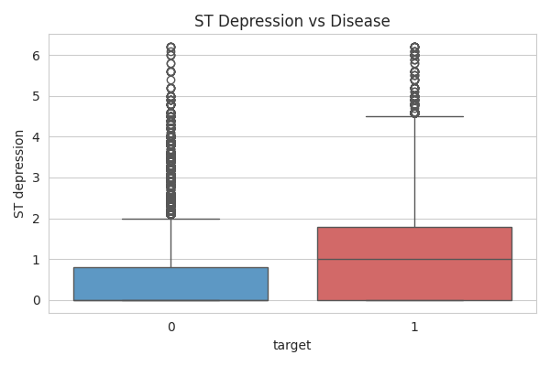
3. EDA — Age vs Max HR & ST Depression
Age vs Max Heart Rate
ST Depression vs Disease
Clear negative trend: older patients achieve lower max HR. r = -0.301 with target. Consistent across both classes.
Disease patients show significantly higher ST depression (r = 0.314). Healthy median near 0 vs elevated disease values — clear physiological signal.
Heart Disease Prediction · March 2026

Slide 7
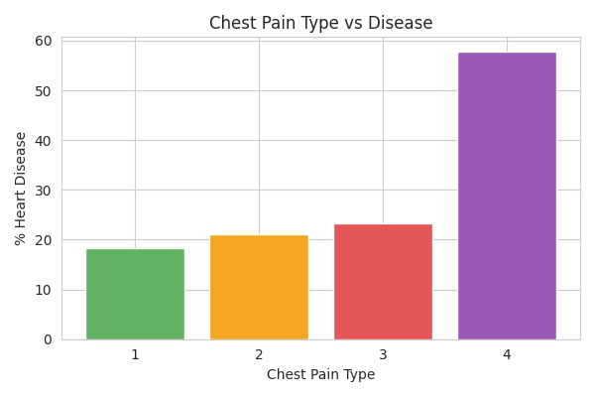
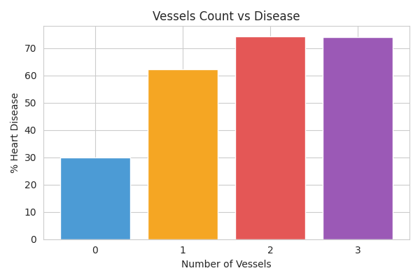
3. EDA — Chest Pain Type & Vessels Fluoroscopy
Chest Pain Type vs Disease Rate
Number of Vessels vs Disease Rate
⚠ Asymptomatic (Type 4) = 57.8% disease rate — highest of all types! Counter-intuitive but clinically documented.
Strong dose-response: 0 vessels → 30% | 1 → 62.2% | 2 → 74.3% | 3 → 74%. r = 0.332 — 2nd strongest predictor.
Heart Disease Prediction · March 2026

Slide 8
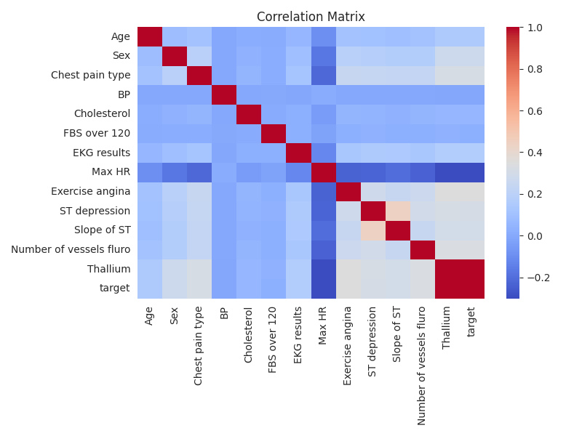
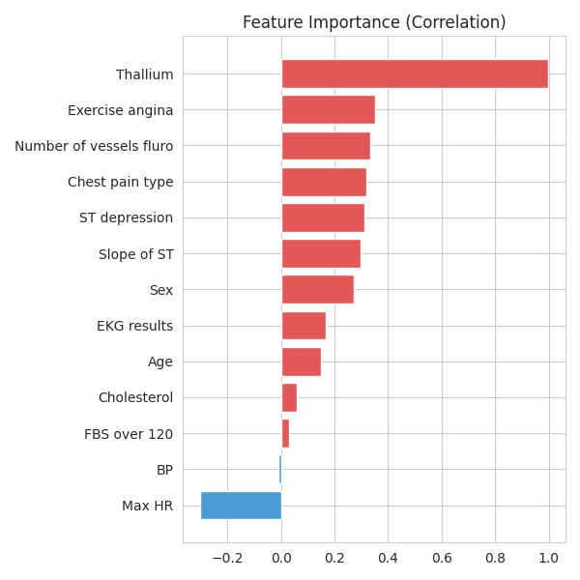
3. EDA — Correlation Matrix & Feature Importance
Correlation matrix shows Thallium ↔ target r=0.998 (data leakage — removed). Top predictors: Exercise angina, Vessels fluro, Chest pain, ST depression, Max HR.
Exercise angina leads at r=0.353. All top 5 features are clinically meaningful cardiac indicators.
Heart Disease Prediction · March 2026

Slide 9
3. EDA — Code Highlights
Key EDA Code (eda.py)
Key Findings
# Load dataset and inspect
df = pd.read_csv("data.csv")
print(df.shape) # (270000, 14)
print(df.isnull().sum()) # → 0 missing
# Target distribution
df["target"].value_counts(normalize=True)
# 0: 59.1% | 1: 40.9%
# Pearson correlation with target
corr = df.corr()["target"].abs()
corr.sort_values(ascending=False)
# Exercise angina: 0.353 (highest)
# Thallium: 0.998 (leakage!)
# Age histogram by class
df.groupby("target")["Age"].hist(alpha=0.6)
# Chest pain disease rate
df.groupby("Chest pain type")["target"].mean()
# Type 4 (Asymptomatic): 57.8%
270,000
records · 0 missing values
r=0.353
Exercise angina — top predictor
57.8%
disease rate for asymptomatic pain
r=0.998
Thallium ↔ target → data leakage!
1.44:1
class ratio — SMOTE not needed
Heart Disease Prediction · March 2026

Slide 10
4. Data Preprocessing — Pipeline
Step | Action | Result
1. Target creation | target = (Thallium != 3) | 0=Normal, 1=Disease
2. Drop Thallium | Remove to prevent data leakage | Clean features only
3. Missing check | df.isnull().sum() — all 14 columns | 0 missing values
4. Train/Test split | 80/20 stratified, random_state=42 | 216k train / 54k test
5. Feature scaling | StandardScaler fit on X_train only | Zero mean, unit variance
6. Save artifacts (v2) | scaler.pkl + columns.pkl saved | Correct inference pipeline
v1 vs v2 — Critical Difference
v1 — MISSING
v2 — FIXED
scaler.pkl not saved
columns.pkl not saved
→ All predictions = 85% wrong
scaler.pkl saved ✓
columns.pkl saved ✓
→ Correct predictions
Heart Disease Prediction · March 2026

Slide 11
4. Preprocessing — Code Highlights
preprocessing.py
Why saving matters
# Create target — remove data leakage
df["target"] = (df["Thallium"] != 3).astype(int)
df = df.drop(columns=["Thallium"])
# Check missing values
print(df.isnull().sum()) # → all 0
# Stratified train/test split
X_train, X_test, y_train, y_test = train_test_split(
X, y, test_size=0.2,
random_state=42, stratify=y)
# Train: 216,000 | Test: 54,000
# Scale — fit on train only
scaler = StandardScaler()
X_train_scaled = scaler.fit_transform(X_train)
X_test_scaled = scaler.transform(X_test)
# v2 FIX: save scaler + column order
with open("processed/scaler.pkl","wb") as f:
pickle.dump(scaler, f)
with open("processed/columns.pkl","wb") as f:
pickle.dump(list(X.columns), f)
Without scaler.pkl:
Model trained on scaled values
(e.g. Age → -2.1)
But web app sends raw values
(e.g. Age = 35)
→ Model sees anomaly → 85% for everyone!
With scaler.pkl saved:
Web app loads same scaler
Applies identical transform
Model receives expected values
→ Correct predictions ✓
Heart Disease Prediction · March 2026

Slide 12
5. Model Selection — Why These 3?
Gradient
Boosting
Random
Forest
Logistic
Regression
Sequential ensemble.
Fixes errors step-by-step.
Strong on tabular clinical data.
Best for feature interactions.
Parallel ensemble.
Robust to overfitting.
Built-in feature importance.
Reliable baseline comparison.
Linear classifier.
Interpretable coefficients.
Fastest training.
Lower-bound reference model.
All 3 optimized with RandomizedSearchCV · 15 iterations · StratifiedKFold · 30k stratified sample for speed
Overfitting check: if train_score − cv_score > 0.05 → flag as overfit
Heart Disease Prediction · March 2026

Slide 13
5. Model Training — Code Highlights
RandomizedSearchCV Optimization
# Sample 30k for fast search (not all 216k)
X_sample, y_sample = resample(
X_train, y_train,
n_samples=30000, stratify=y_train)
# Define search space
param_dist = {
"n_estimators": [200, 300, 500],
"learning_rate": [0.01, 0.05, 0.1],
"max_depth": [2, 3, 4],
"subsample": [0.6, 0.8],
}
# RandomizedSearchCV
search = RandomizedSearchCV(
GradientBoostingClassifier(),
param_dist, n_iter=15,
scoring="recall", cv=5,
return_train_score=True)
search.fit(X_sample, y_sample)
# Overfitting check
diff = train_score - cv_score
if diff <= 0.05:
print("Stable ✓")
elif train_score >= 0.90:
print("Overfitting!")
# Retrain on FULL data
model = GradientBoostingClassifier(
**search.best_params_)
model.fit(X_train, y_train)
Heart Disease Prediction · March 2026

Slide 14
6. Model Comparison — Results
Model | Accuracy | Precision | Recall | F1-Score | ROC-AUC
Gradient Boosting ★ | 76.54% | 72.44% | 68.76% | 70.55% | 82.52%
Random Forest | 75.93% | 68.82% | 75.13% | 71.83% | 82.33%
Logistic Regression | 75.85% | 69.35% | 73.27% | 71.26% | 82.06%
Heart Disease Prediction · March 2026

Slide 15
7. Final Model — Gradient Boosting
Leads in 4 out of 5 metrics across both initial and optimized evaluation
76.54%
72.44%
70.55%
82.52%
Accuracy
Precision
F1-Score
ROC-AUC
Note: Random Forest has best Recall (75.13%) — catches more disease cases. But Gradient Boosting wins overall balance across all 5 metrics.
Heart Disease Prediction · March 2026

Slide 16
8. Web Application Architecture
Stack & File Structure
Prediction Flow
FastAPI — backend REST API framework
Uvicorn — ASGI server
Jinja2 — HTML templating engine
scikit-learn — model & scaler loading
sessionStorage — patient history (browser)
1
User fills form (12 fields)
2
Build DataFrame (columns.pkl)
3
Scale input (scaler.pkl)
web_site/
├── main.py ← FastAPI backend
├── requirements.txt
├── templates/
│ └── index.html ← Form + result
└── static/
└── style.css ← All styling
4
Predict probability (model.pkl)
5
Classify risk → render result card
Heart Disease Prediction · March 2026

Slide 17
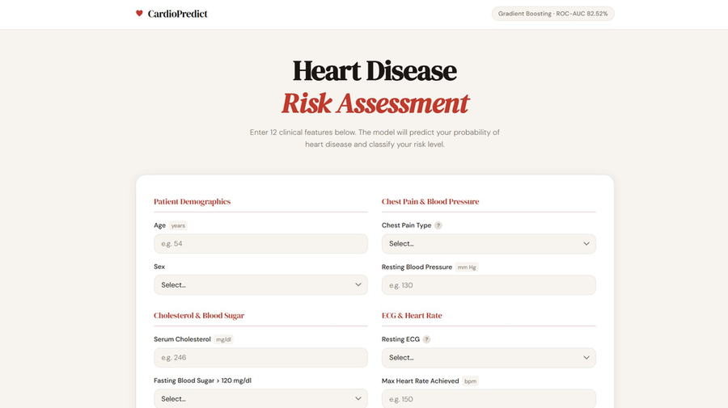
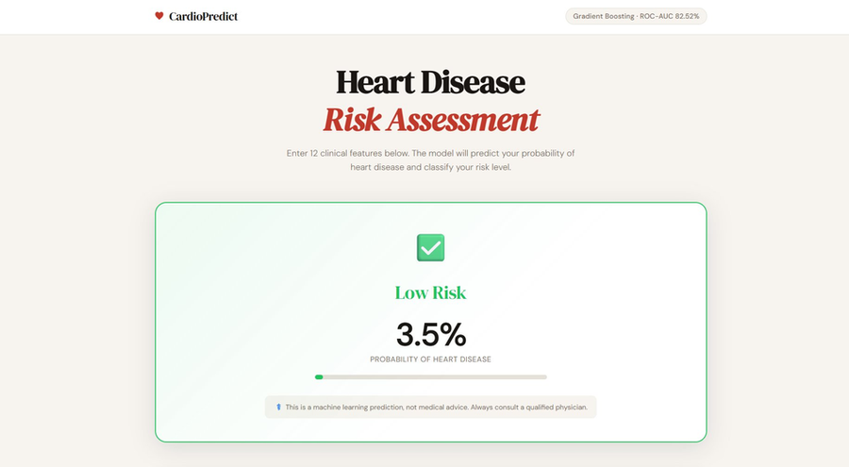
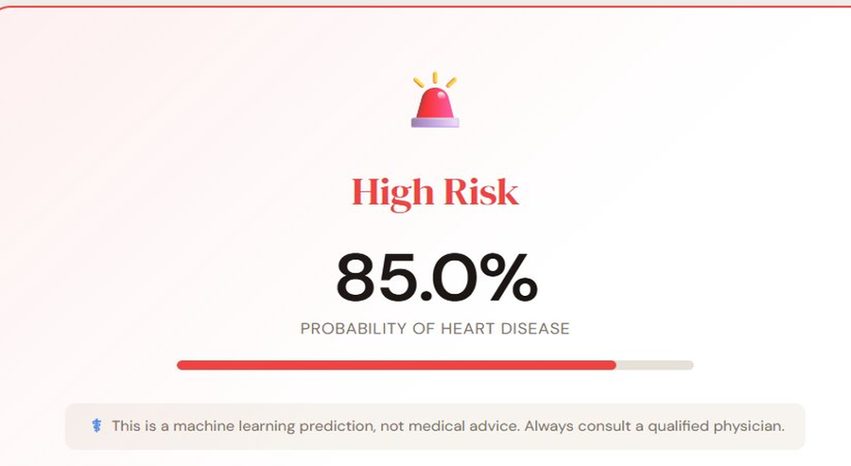
8. Web Application — Interface
Low Risk — 3.5% · Green border + bar
Main form — 12 fields in 6 grouped sections. DM Serif Display font, warm clinical palette, sticky header with heartbeat animation.
High Risk — 85% · Full red bar
Heart Disease Prediction · March 2026

Slide 18
8. Web Application — Code Highlights
main.py — FastAPI Backend
Run Command
# Load at startup — once
with open(MODEL_PATH, "rb") as f:
model = pickle.load(f)
with open(SCALER_PATH, "rb") as f:
scaler = pickle.load(f)
with open(COLUMNS_PATH, "rb") as f:
feature_columns = pickle.load(f)
# Prediction route
@app.post("/predict")
async def predict(
age: float = Form(...),
sex: float = Form(...),
... # 12 fields
):
input_df = pd.DataFrame([{
feature_columns[0]: age, ...}])
scaled = scaler.transform(input_df)
prob = model.predict_proba(scaled)[0][1]
if prob < 0.35: risk = "Low Risk"
elif prob < 0.60: risk = "Moderate Risk"
else: risk = "High Risk"
uvicorn main:app --reload
Model loaded successfully Scaler loaded successfully Feature columns: ['Age', ...] Uvicorn running on http://127.0.0.1:8000
Patient History (JS)
function getHistory() {
return JSON.parse(
sessionStorage.getItem(KEY));
}
history.push({name,age,prob,risk});
sessionStorage.setItem(
KEY, JSON.stringify(history));
Heart Disease Prediction · March 2026

Slide 19
9. Challenges & Solutions
Challenge
Problem
Solution
Missing Form(...)
All form values = 0 in FastAPI route
Added = Form(...) to every parameter
Scaler not saved
No scaler.pkl → impossible to scale input
Added pickle.dump(scaler) to preprocessing
85% for all patients
Raw unscaled input → wrong predictions
Load & apply scaler.transform() in main.py
Slow search (>30 min)
270k × 50 combos × 5 folds = too slow
Search on 30k sample, retrain on full data
Heart Disease Prediction · March 2026

Slide 20
10. Technologies Used
Python 3.13
FastAPI + Uvicorn
Core language
Web deployment
pandas / numpy
Jinja2 + HTML/CSS
Data processing
Frontend interface
scikit-learn
PyCharm
Models, scaler, search
Development IDE
pickle
ChatGpt (AI)
Model serialization
Debugging & Optimization
Heart Disease Prediction · March 2026

Slide 21
Results Summary
Final model tested — all 3 patients predicted correctly
Patient 1
Patient 2
Patient 3
Age 32 · Female
Healthy vitals
Age 50 · Male
Moderate flags
Age 63 · Male
High risk profile
3.5%
40.6%
87.4%
Low Risk
Moderate Risk
High Risk
Gradient Boosting · Accuracy 76.54% · ROC-AUC 82.52% · Deployed via FastAPI
Heart Disease Prediction · March 2026

